Slide 1


Lesson 14
Talking about future plans
UNIT 4

Slide 2
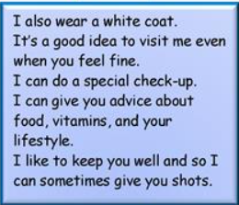
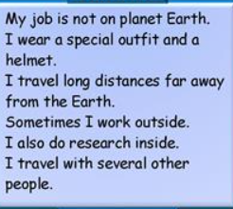
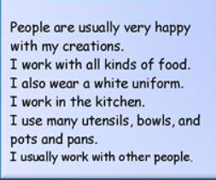
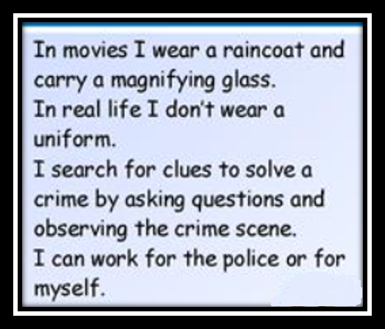
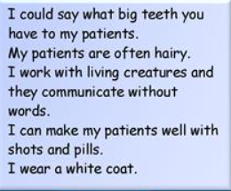
GUESS MY JOB!
A CHEF
A DOCTOR
AN ASTRONAUT
A DETECTIVE
A DENTIST

Slide 3
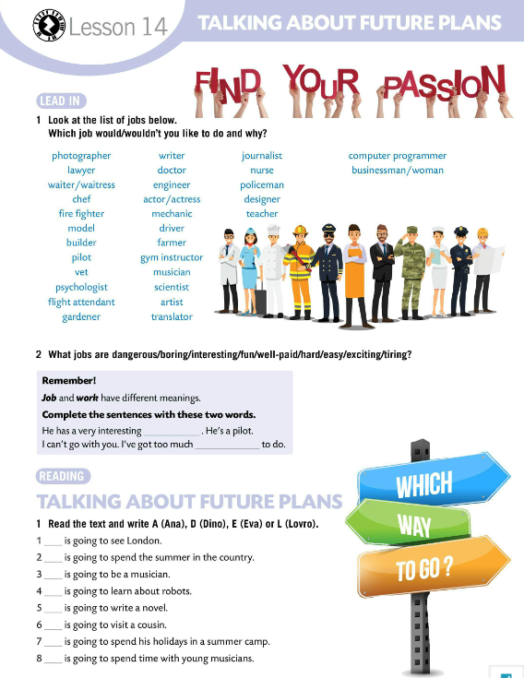
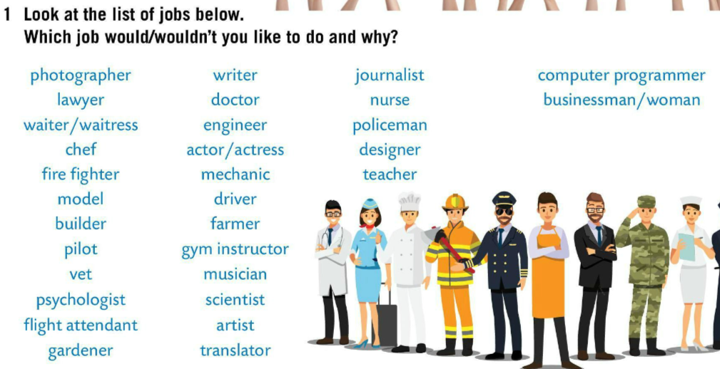
Look at the list of jobs in Task 1. Which job would/wouldn’t you like to do and why?
Translate all the jobs into Croatian.
How do you say the names of the following jobs in Croatian?
a lawyer
a flight attendant
a waiter/a waitress
a scientist
a translator
a journalist
odvjetnik/odvjetnica
stjuard/stjuardesa
konobar/konobarica
znanstvenik/znanstvenica
prevoditelj/prevoditeljica
novinar/novinarka
What jobs are dangerous / boring / fun / well-paid / hard / easy / exciting / tiring?

Slide 4
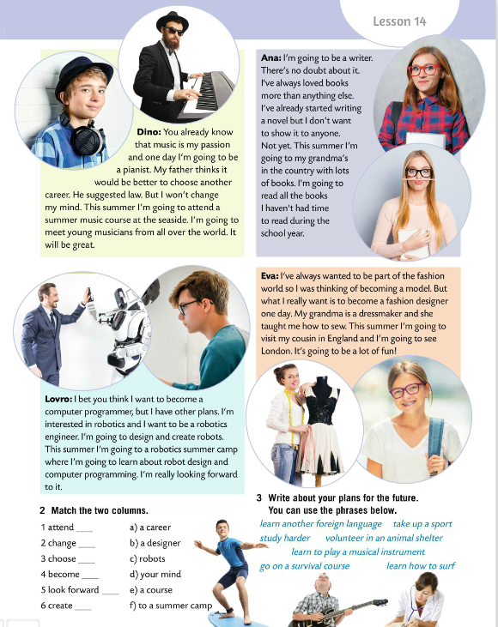
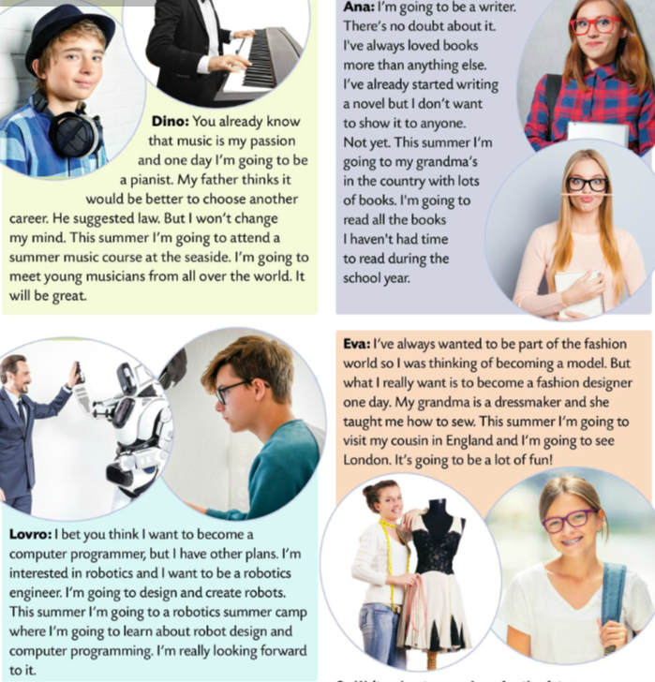
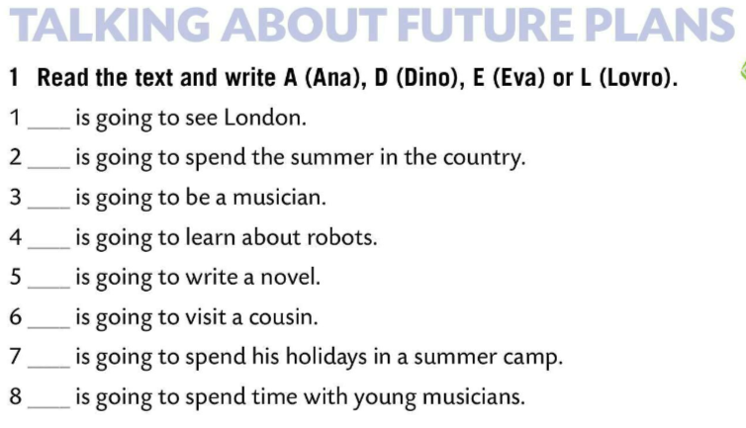
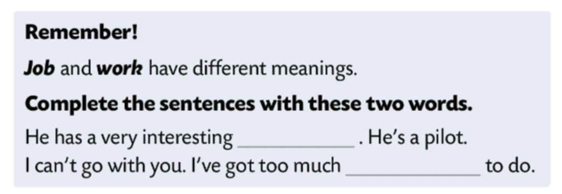
Complete the sentences with these two words.
Check.
Remember!
JOB and work have different meanings.
Work refers to an activity which requires effort or energy to achieve something (an aim or task).
Job refers to a position or employment role (a cook, a teacher or a banker).
Eva
Ana
Dino
Lovro
Ana
job
Eva
work
Lovro
Dino
Read the text and write A (Ana), D (Dino), E (Eva) or Lovro (L).
Check.

Slide 5
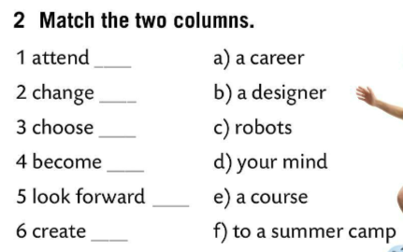
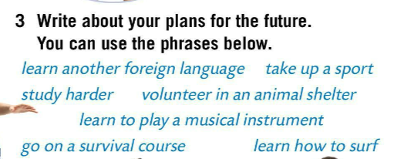
Read the text again. Match the two columns.
Check.
attend a course – pohađati tečaj
change your mind – predomisliti se
choose a carrer – profesionalna orijentacija
become a designer – postati dizajner
look forward to a summer camp – radovati se ljetnom kampu
create robots – stvarati robote
e)
d)
a)
b)
f)
c)
Write about your plans for the future. You can use the phrases below.

Slide 6
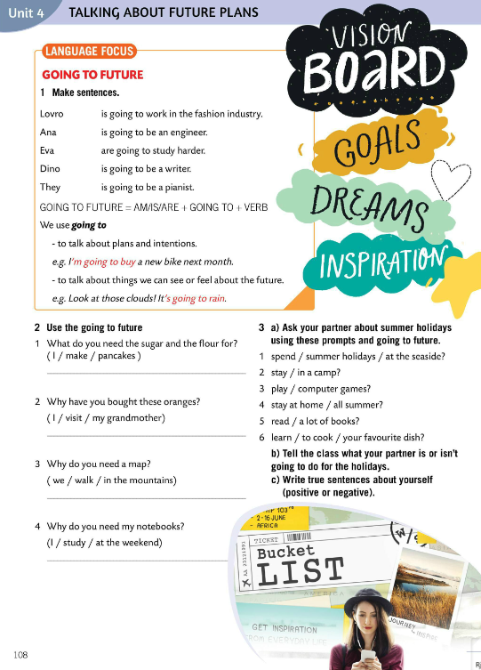
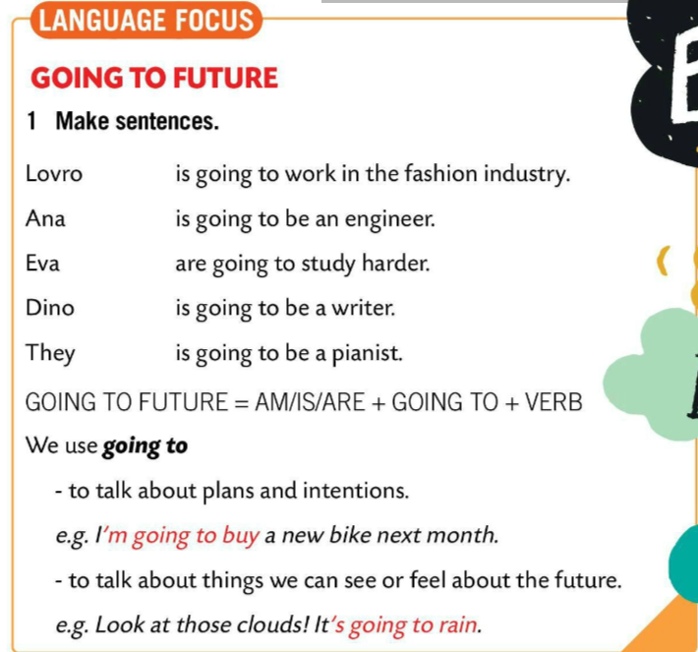
Make sentences in Task 1.
Check.
Lovro is going to be an engineer.
Ana is going to be a writer.
Eva is going to work in the fashion industry.
Dino is going to be a pianist.
They are going to study harder.

Slide 7
LANGUAGE FOCUS
We use going to to talk about plans and intentions.
Going to koristimo kada govorimo o budućim planovima i namjerama.
e.g. I’m going to buy a new bike next month.
We use going to to talk about things we can see or feel about the future.
Going to koristimo za opisivanje predviđanja temeljenima na dostupnim, trenutnim dokazima.
e.g. Look at those clouds! It’s going to rain.
AM/IS/ ARE + GOING TO + VERB = GOING TO FUTURE

Slide 8
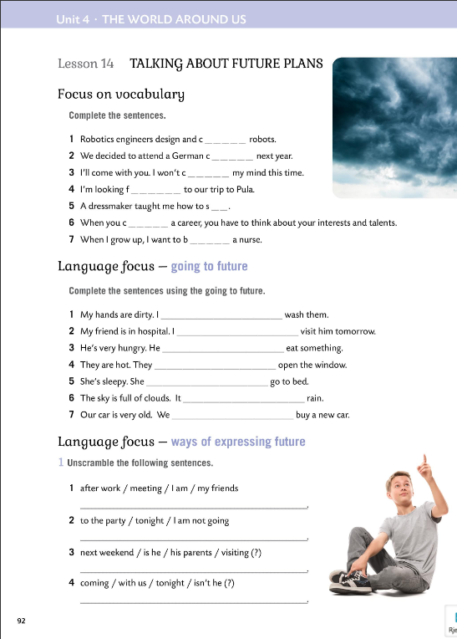
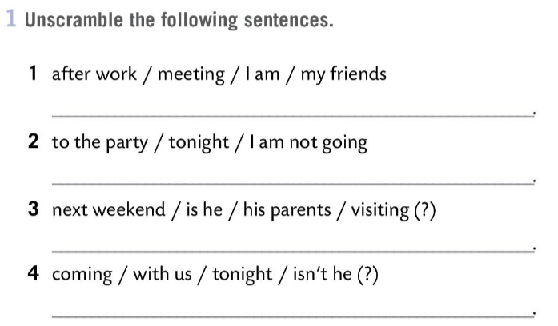

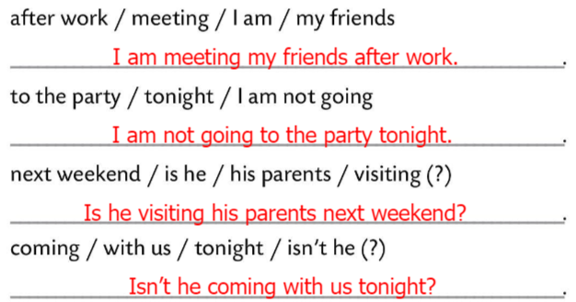
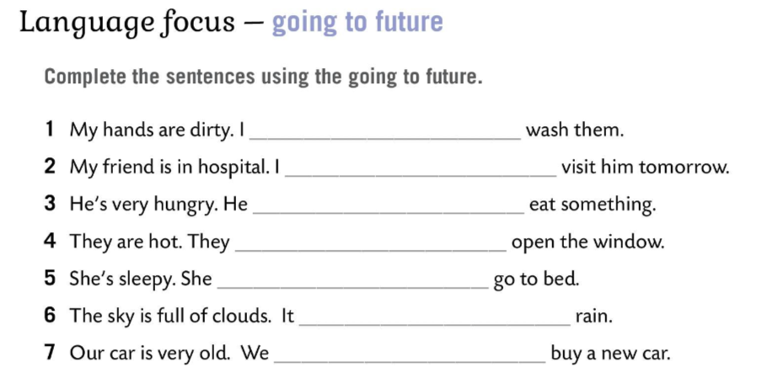
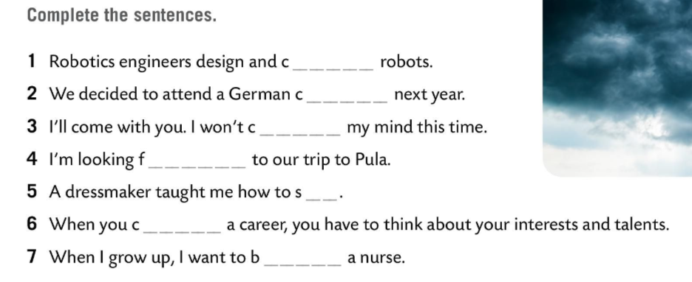
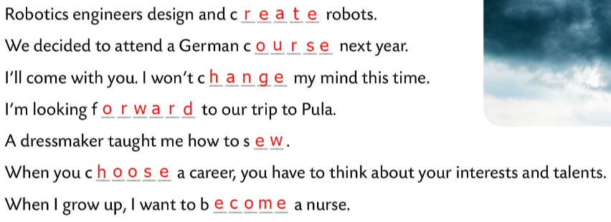
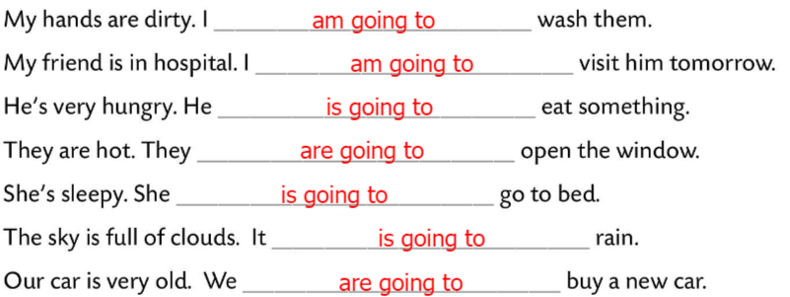
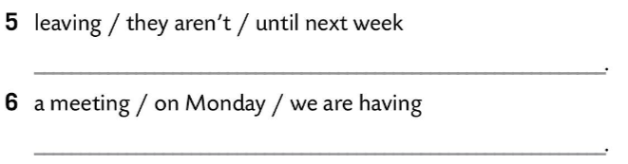
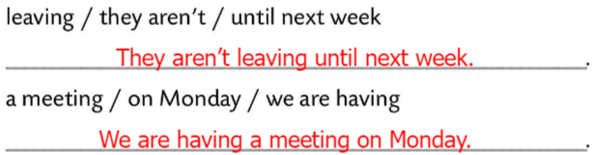
Workbook, page 92
Complete the sentences.
Check.
Complete the sentences using the going to future.
Check.
Unscramble the following sentences.
Check.

Slide 9
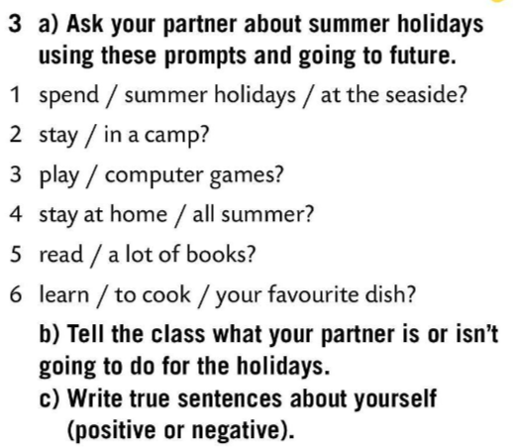
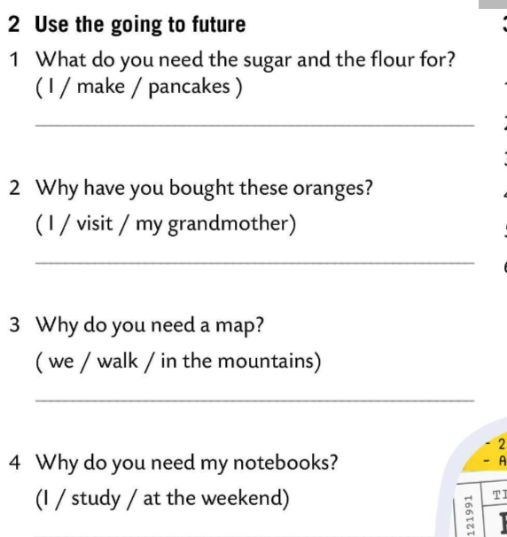
Use going to future in Task 2.
Check.
Ask your partner about summer holidays. Use these prompts and going to future.
I’m going to make pancakes.
Tell the class what your partner is or isn’t going to do for the holidays.
I’m going to visit my grandmother.
Write true sentences about yourself (positive or negative.)
We’re going to walk in the mountains.
Choose the correct form of expressing future.
https://learningapps.org/watch?v=psk3cba7520
I’m going to study at the weekend.

Slide 10
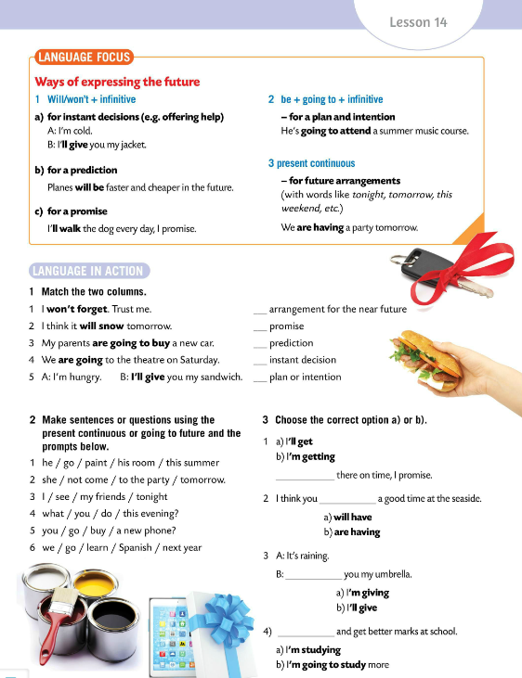
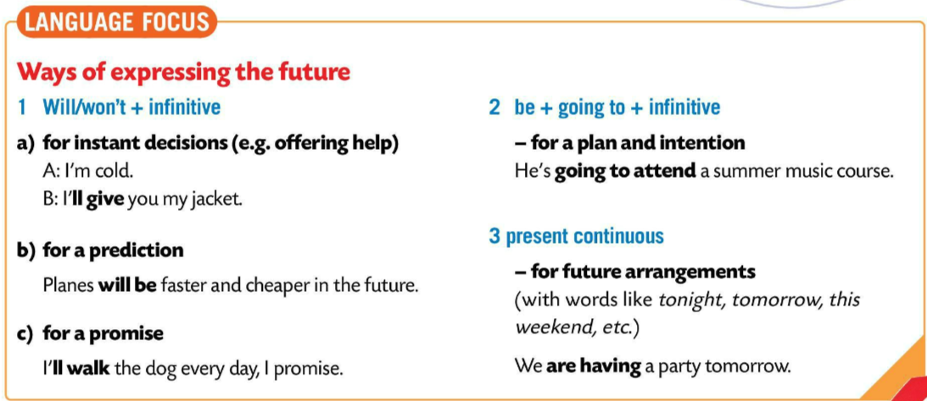
LANGUAGE FOCUS
There are three ways of expressing future:
1 WILL/WON’T + INFINITIVE
a) for instant decisions (e.g. offering help)
a) odluke donesene na licu mjesta (nudimo pomoć)
e.g. I’ll help you.
b) for a prediction
b) za pretpostavke i predviđanja
e.g. Planes will be faster and cheaper in the future.
c) for a promise
c) za obećanja
e.g. I’ll walk the dog every day, I promise.

Slide 11
2) BE + GOING TO + INFINITIVE
a) for a plan and intention
a) za buduće planove i namjere
e.g. He’s going to attend a summer music course.
3) PRESENT CONTINUOUS
a) for future arrangements
a) za izražavanje buduće radnje koju smo već isplanirali
e.g. We are having a party tomorrow.

Slide 12
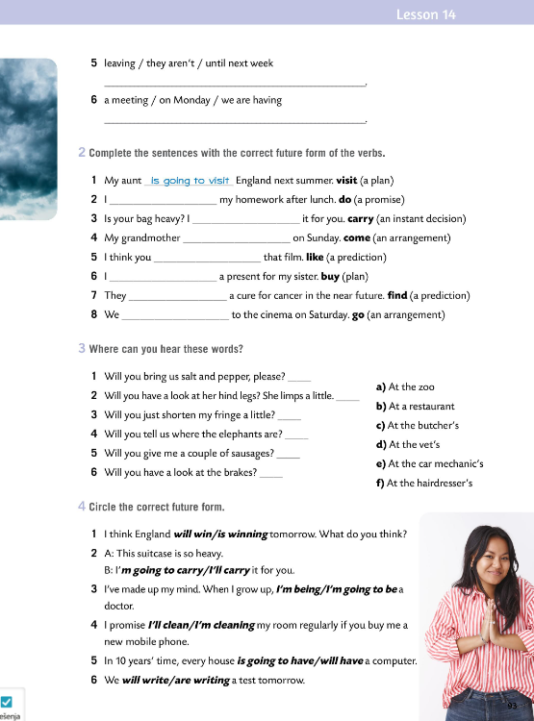
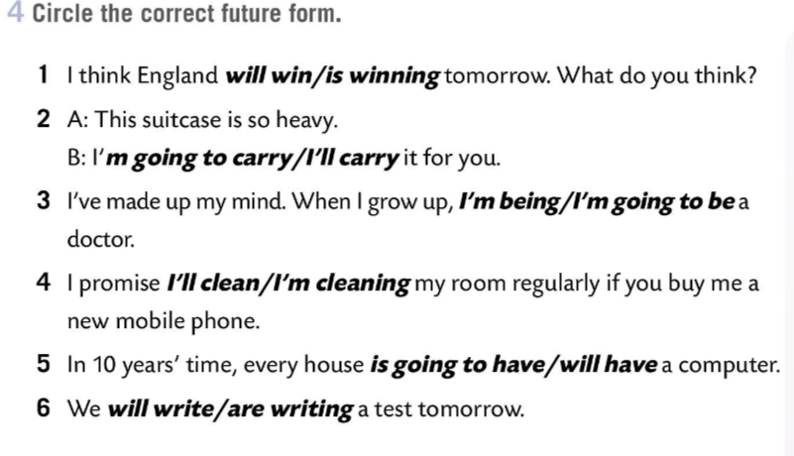
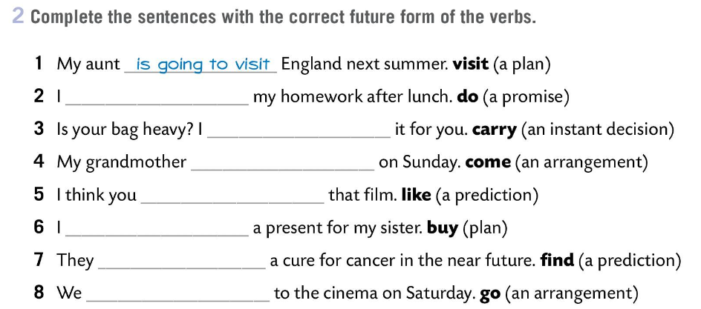
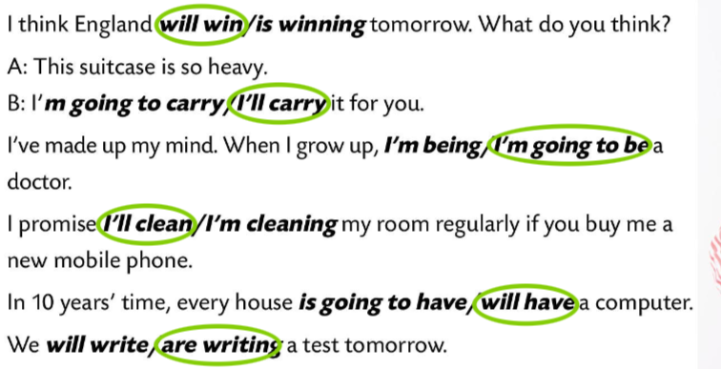
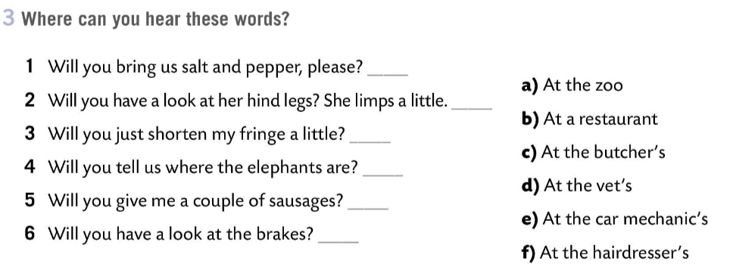
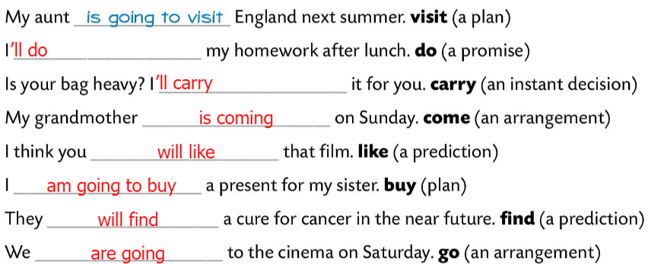
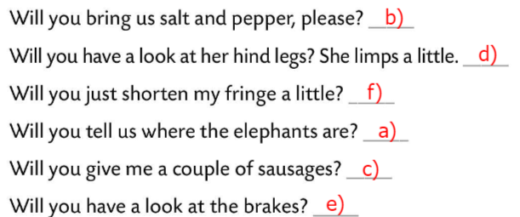
Workbook, page 93
Complete the sentences with the correct future form of the verbs.
Check.
Where can you hear these words?
Check.
Circle the correct future form.
Check.

Slide 13
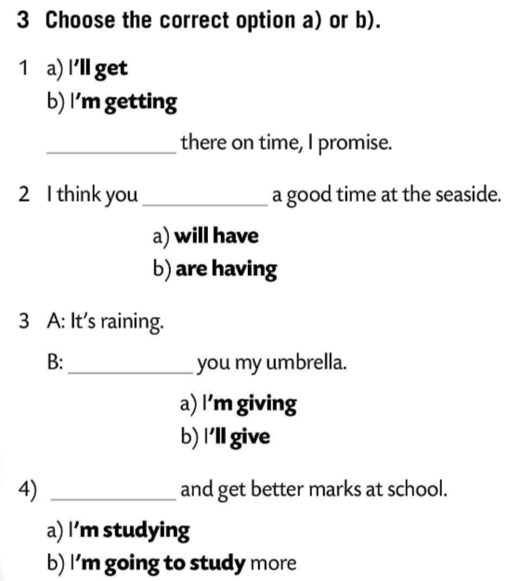
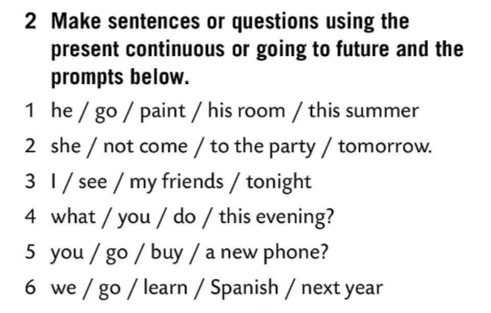
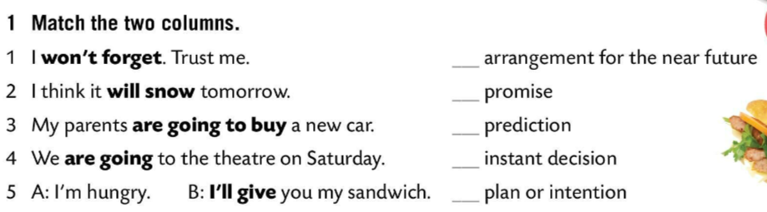
Match the two columns.
Copy.
Make sentences or questions using the present continuous or going to future and the prompts below.
4
He is going to paint his room this summer.
Copy.
1
She’s not coming to the party tomorrow.
2
5
I’m seeing my friends tonight.
3
Choose the correct option a) or b).
What are you doing this evening?
Are you going to buy a new phone?
Copy.
We are going to learn Spanish next year.
Drag and drop each keyword to its definition.
https://wordwall.net/play/853/485/577

